Slide 1
Recursive descent parsing
Programming Language Design and Implementation (4th Edition)
by T. Pratt and M. Zelkowitz
Prentice Hall, 2001
Section 3.4

Slide 2
Recursive descent parsing overview
A simple parsing algorithm
Shows the relationship between the formal description of a programming language and the ability to generate executable code for programs in the language.
Use extended BNF for a grammar, e.g., expressions:
<arithmetic expression>::=<term>{[+|-]<term>}*
Consider the recursive procedure to recognize this:
procedure Expression;
begin
Term; /* Call Term to find first term */
while ((nextchar=`+') or (nextchar=`-')) do
begin
nextchar:=getchar; /* Skip over operator */
Term
end
end

Slide 3
Generating code
Assume each procedure outputs its own postfix (Section 8.2, to be discussed later)
To generate code, need to output symbols at appropriate places in procedure.
procedure Expression;
begin
Term; /* Call Term to find first term */
while ((nextchar=`+') or (nextchar=`-')) do
begin
nextchar:=getchar; /* Skip over operator */
Term; output previous ‘+’ or ‘-’;
end
end

Slide 4
Generating code (continued)
Each non-terminal of grammar becomes a procedure.
Each procedure outputs its own postfix.
Examples:
procedure Term;
begin
Primary;
while ((nextchar=`*') or (nextchar=`/')) do
begin
nextchar:=getchar; /* Skip over operator */
Primary; output previous ‘*’ or ‘/’;
end
end
Procedure Identifier;
begin
if nextchar= letter output letter else error;
nextchar=getchar;
end
Figure 3.13 of text has complete parser for expressions.

Slide 5
Recursive Descent Parsing
Recall the expression grammar, after transformation
This produces a parser with six
mutually recursive routines:
• Goal
• Expr
• EPrime
• Term
• TPrime
• Factor
Each recognizes one NT or T
The term descent refers to the
direction in which the parse tree
is built.

Slide 6
Recursive Descent Parsing
A couple of routines from the expression parser

Slide 7
Transition diagrams for the grammar
ε
Grammar
E E' T T' F | → → → → → | TE' +TE' | ε FT' *FT' | ε (E) | id
ε

Slide 8
Simplified transition diagrams.
(a)
(b)
ε
⇒
ε
ε
⇒
ε
ε
(c)
(d)

Slide 9
Simplified transition diagrams for arithmetic expressions.
ε
ε

Slide 10
Example transition diagrams
Corresponding transition diagrams:
An expression grammar with left recursion and ambiguity removed:
E’ -> + T E’ | ε
T -> F T’
T’ -> * F T’ | ε
F -> ( E ) | id
E -> T E’

Slide 11
Predictive parsing without recursion
To get rid of the recursive procedure calls, we maintain our own stack.

Slide 12
Example
Use the table-driven predictive parser to parse
id + id * id
Assuming parsing table
Initial stack is $E
Initial input is id + id * id $

Slide 13
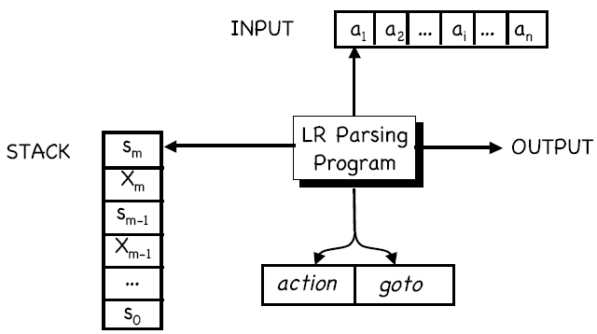
LR parsing

Slide 14
LR parsing example
Grammar:
1. E -> E + T
2. E -> T
3. T -> T * F
4. T -> F
5. F -> ( E )
6. F -> id

